Slide 1

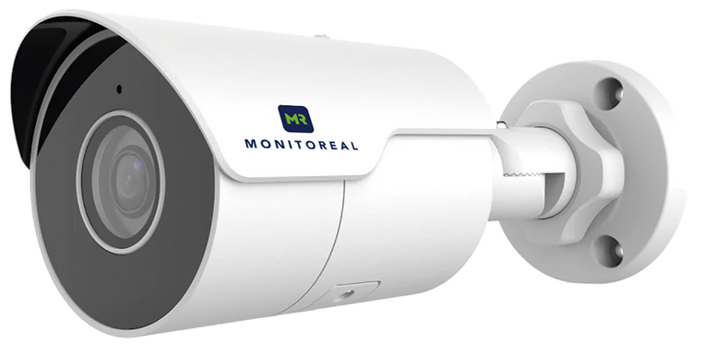


Proactive AI-Powered
Perimeter Protection
For your home, business and more See What Matters
lax.co.id

Slide 2


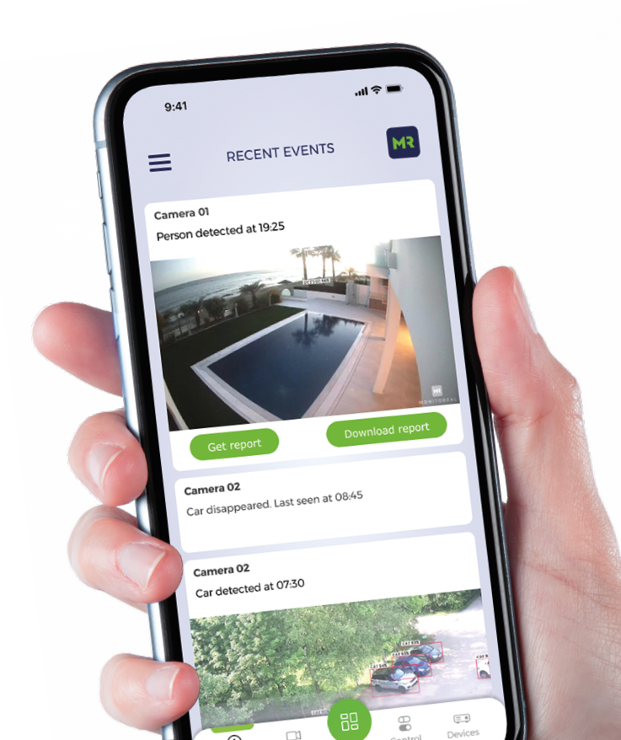
Meet Monitoreal
We are Monitoreal, a global manufacturer of AI-based security surveillance systems.
Our mission is to help people feel secure in their homes and protect their small businesses, by providing innovative solutions that are effective, affordable, and easy to use.
Our intelligent surveillance systems are designed to help you monitor your surroundings in real-time, with customizable alerts and smart audio and light accessories that can help deter intruders.
See what matters with Monitoreal.
lax.co.id

Slide 3



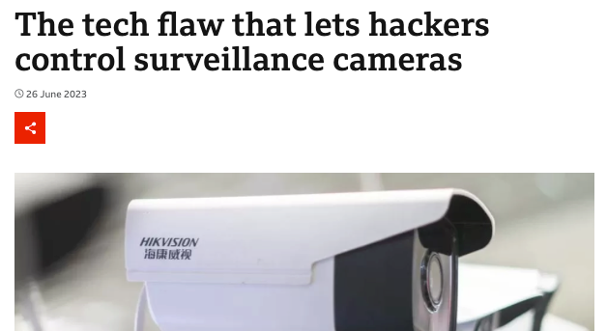

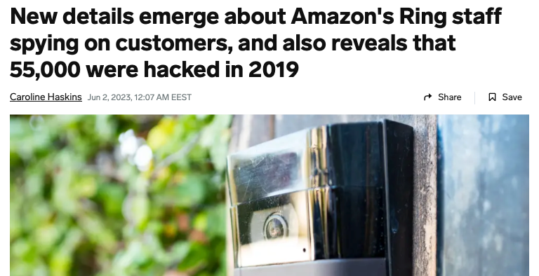




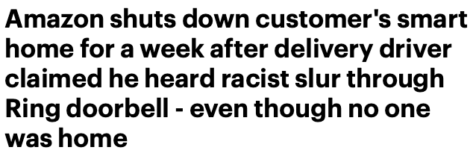


The Opportunity
Cloud-based security systems have become increasingly vulnerable to hacking
lax.co.id

Slide 4
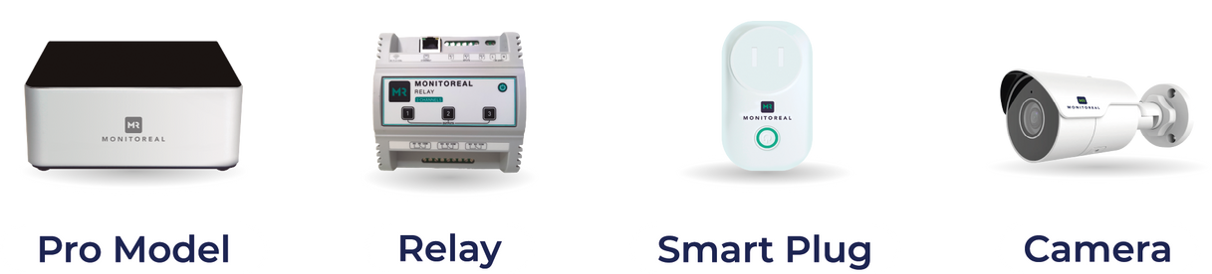








The Solution
Monitoreal’s key features include:
Assistants
No cloud
Real-time alerts
Connect any camera brand
One-time purchase
Integrate alarms with relays
Absolute data privacy
Bolt-on or new installations
Electrical device automation
lax.co.id

Slide 5
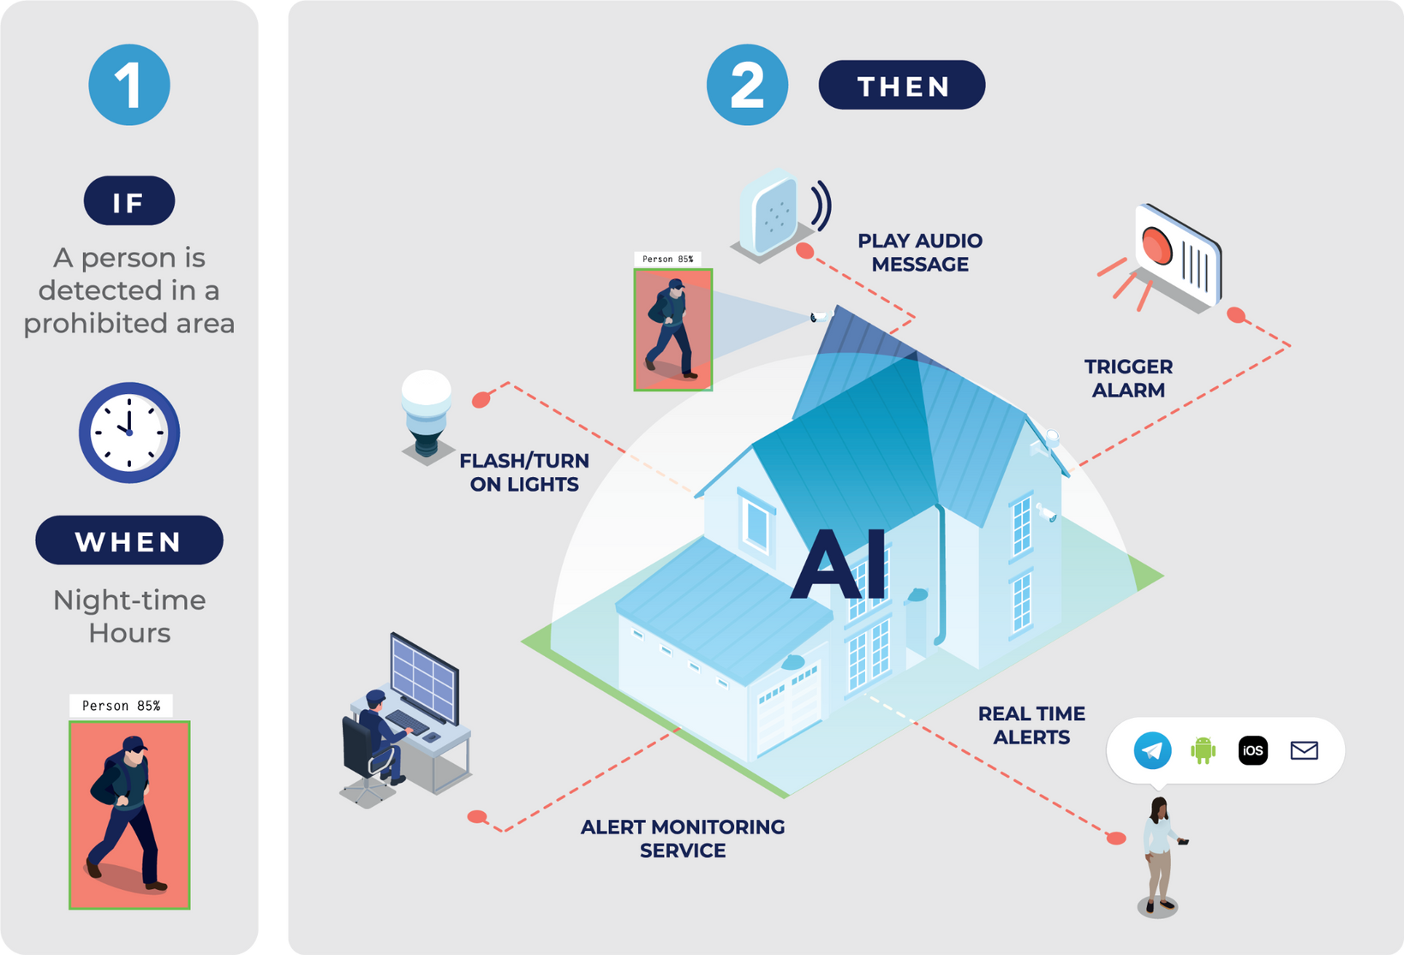
Smart Object Detection
24+ object classifications available
AI-based smart object detection technology
lax.co.id

Slide 6
Target markets
Capturing opportunities
Market Focus
  Traditional security and smart home markets
  Why? Strong demand projected for AI and Smart safety and security solutions
  Market Gap
  Identified through market analysis
  A clear need for affordable, on-premise AI-based video surveillance solutions
Meet Consumer Needs
  Both consumers and SMEs seek safety and security solutions
  Homes, businesses, and assets are a priority
  Market Potential
  Current global video surveillance market valued at $45.5 billion
  AI technology integration will drive it to $100 billion by 2025
lax.co.id

Slide 7
Market landscape overview
Monitoreal fills the gap in SMB & Smart Home segments
Enterprise-level solutions
  Expensive
  Complex installations and setup
  Cloud-based consumer products
  High false alerts (motion detection)
  Limited resolution/ lens options
  Recurring fees
  Cybersecurity risks
‘Free’ video analytics in NVRs and cameras
  Limited analytics options
  Higher false alarm rates
  Not user-friendly
Add logos
lax.co.id
Notes:
Alternative solutions in the market don’t meet consumer needs

Slide 8



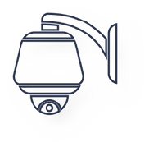
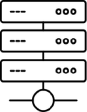


Suitable surveillance solutions
For homeowners and small businesses?
DVR/NVR with motion detection + inaccurate analytics
6-8 cameras
Cloud server in unknown location, managed by unknown staff
App by manufacturer with video feed from server (needs unlimited data plan)
lax.co.id

Slide 9




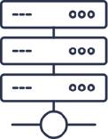


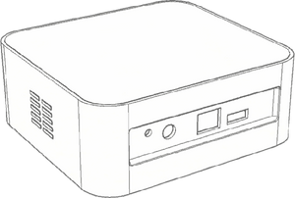


Video security assistant as a bolt-on
And smart home device
Smart surveillance system powered by Monitoreal
Up to 8 cameras supported
‘Dumb’ surveillance system
With a DVR/NVR
DVR/NVR
DVR/NVR
Monitoreal
Relay
Monitoreal
AI Security Assistant
lax.co.id

Slide 10
How it works
lax.co.id
Notes:
Set rules to detect unauthorised objects in detection zones
Objects are detected even when partially obstructed from view
Expertly handles difficult light and weather conditions
Ignore false triggers, visual noise, irrelevant distractions

Slide 11
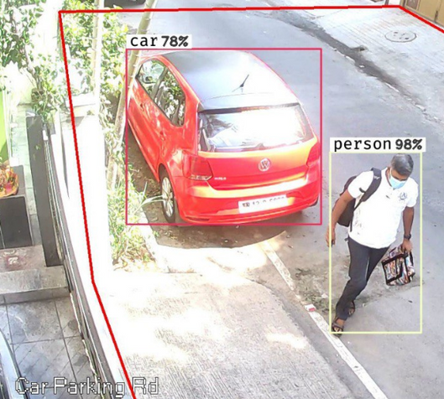
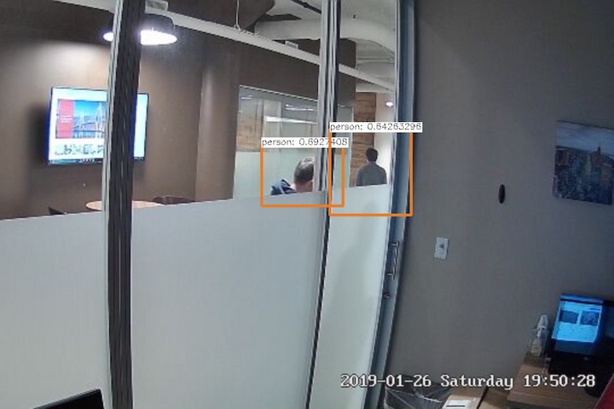
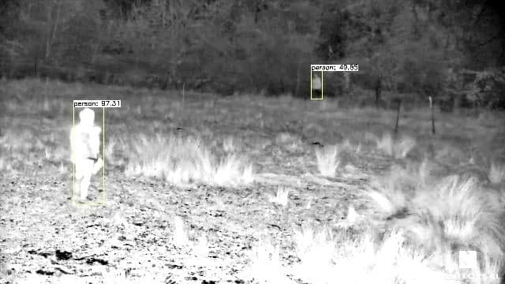
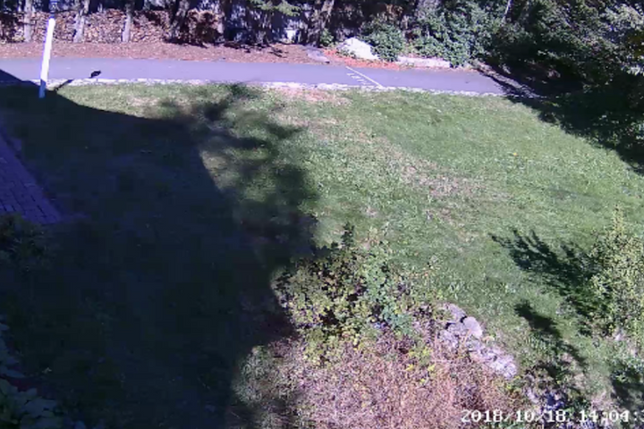
How the AI works
Set rules to detect unauthorised objects in detection zones
Objects are detected even when partially obstructed from view
Expertly handles difficult light and weather conditions
Ignore false triggers, visual noise, irrelevant distractions
lax.co.id

Slide 12
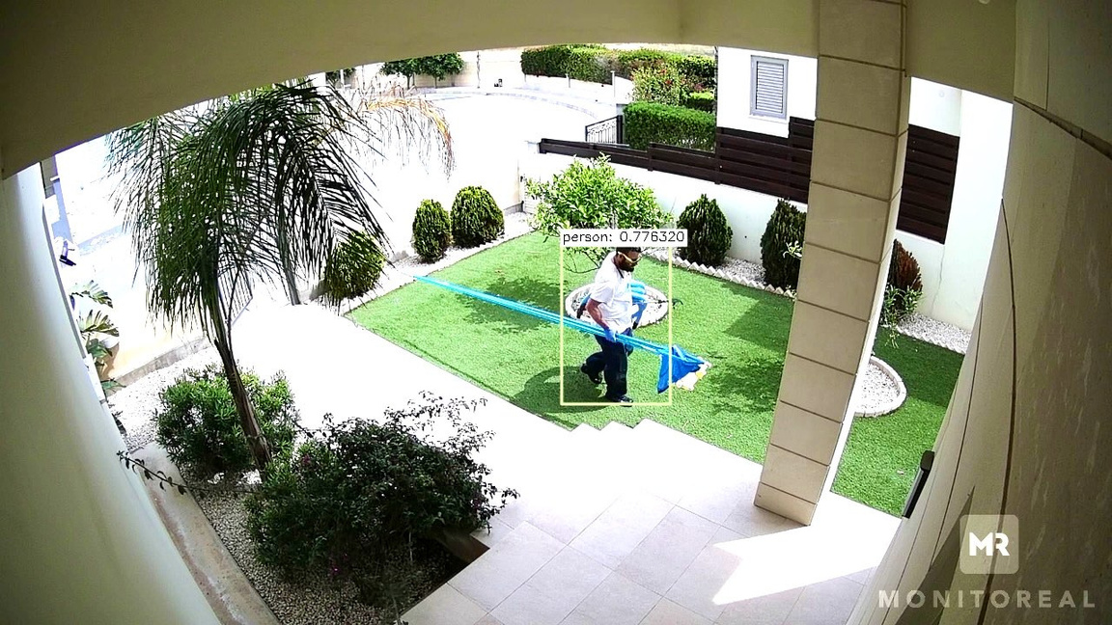
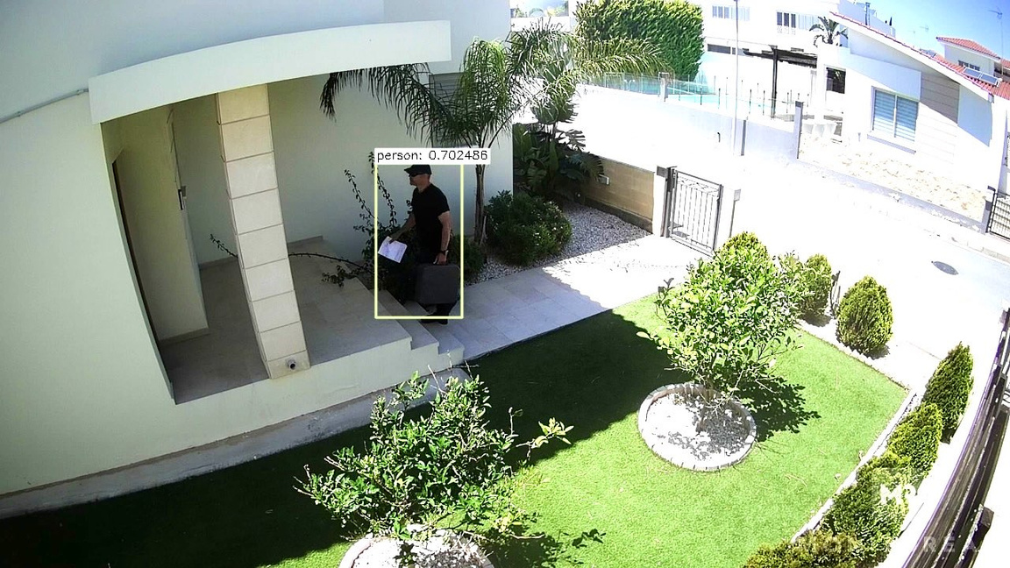
Detection examples
People
lax.co.id

Slide 13
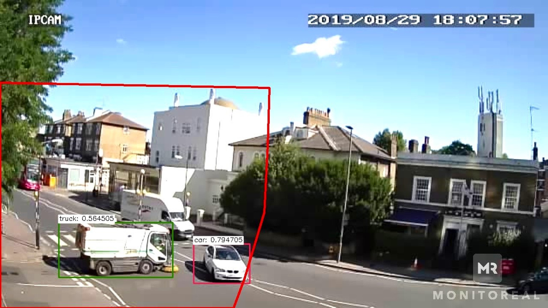
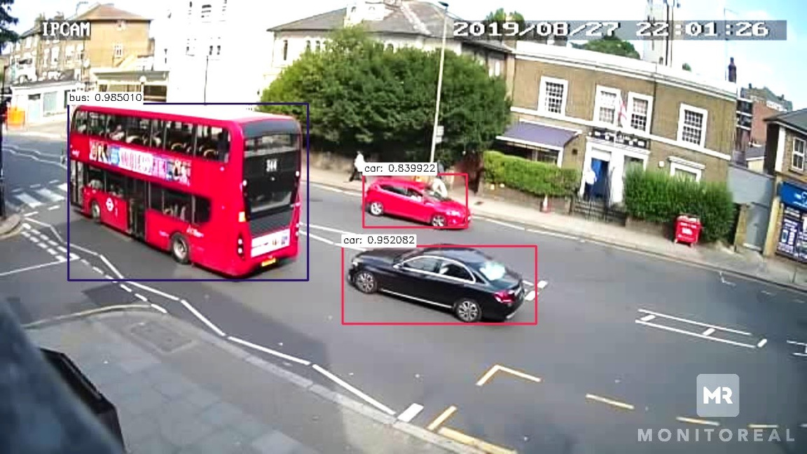
Detection examples
Vehicles
lax.co.id

Slide 14
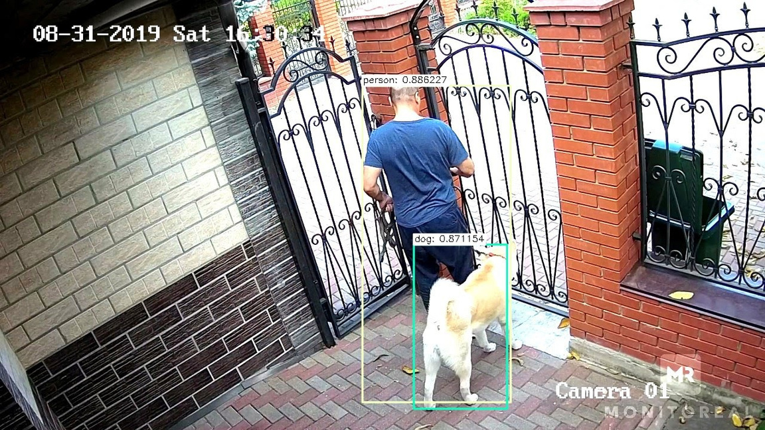
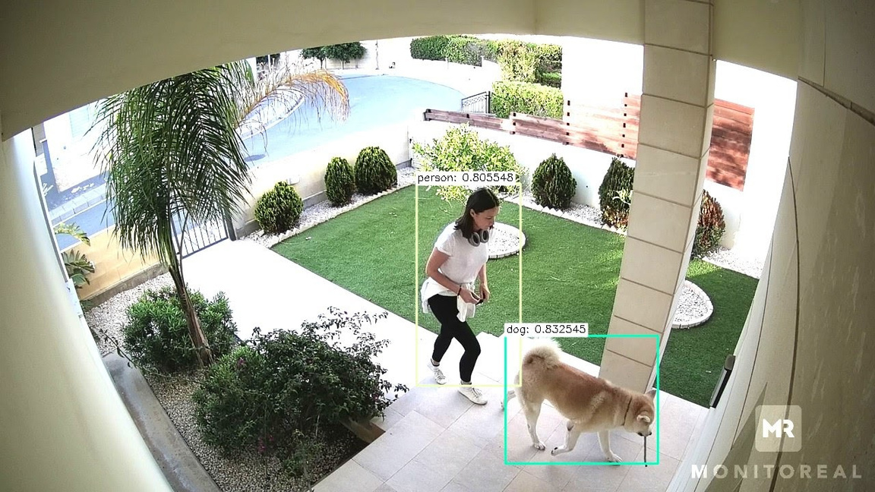
Detection examples
Animals
lax.co.id

Slide 15
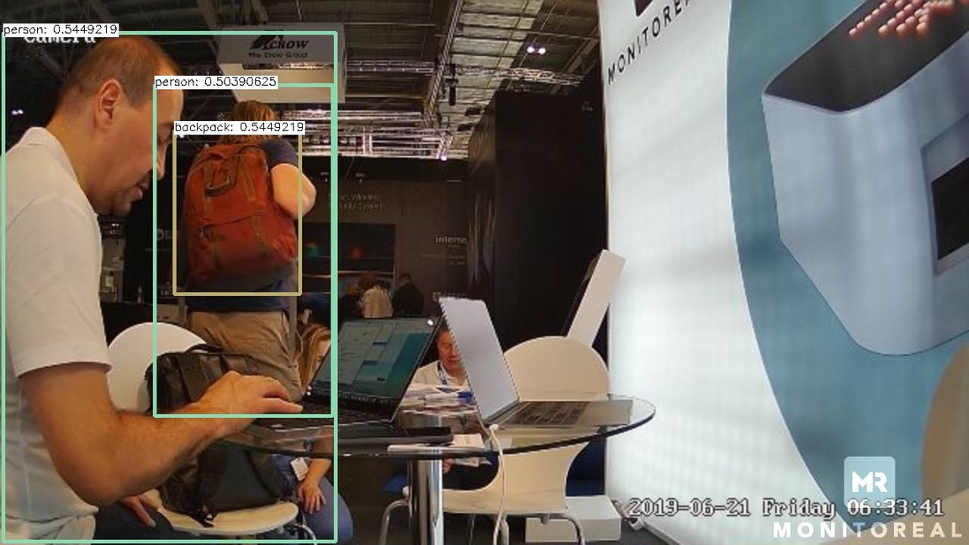
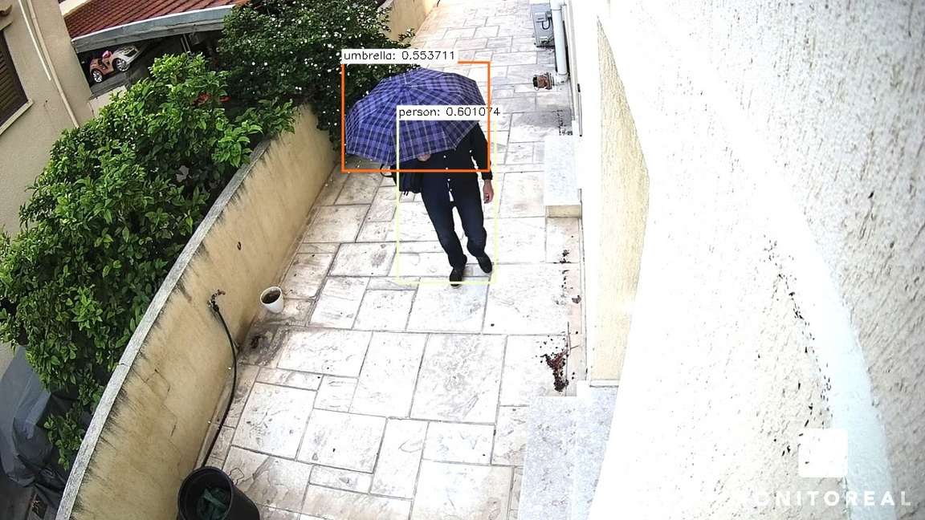
Detection examples
And more
lax.co.id

Slide 16
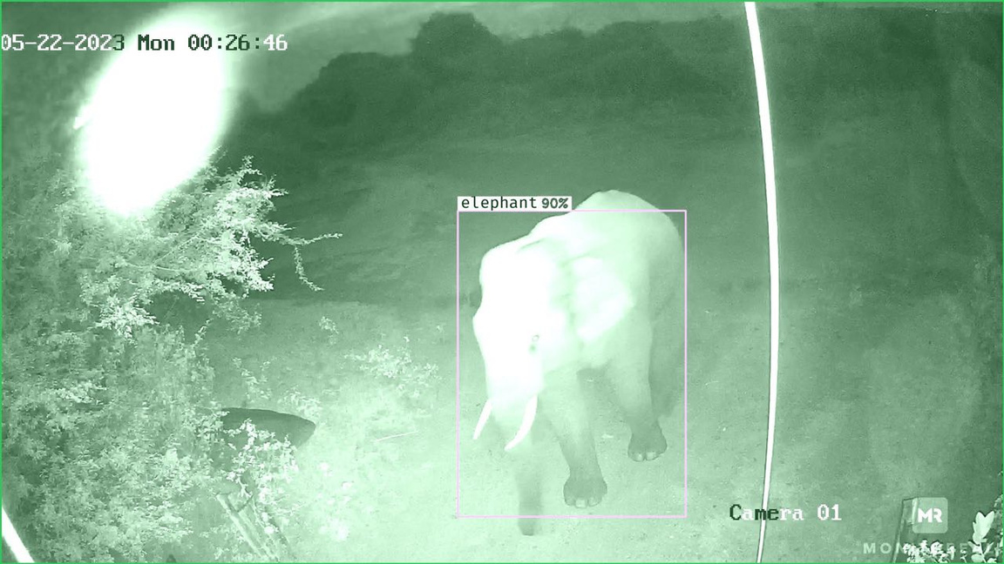
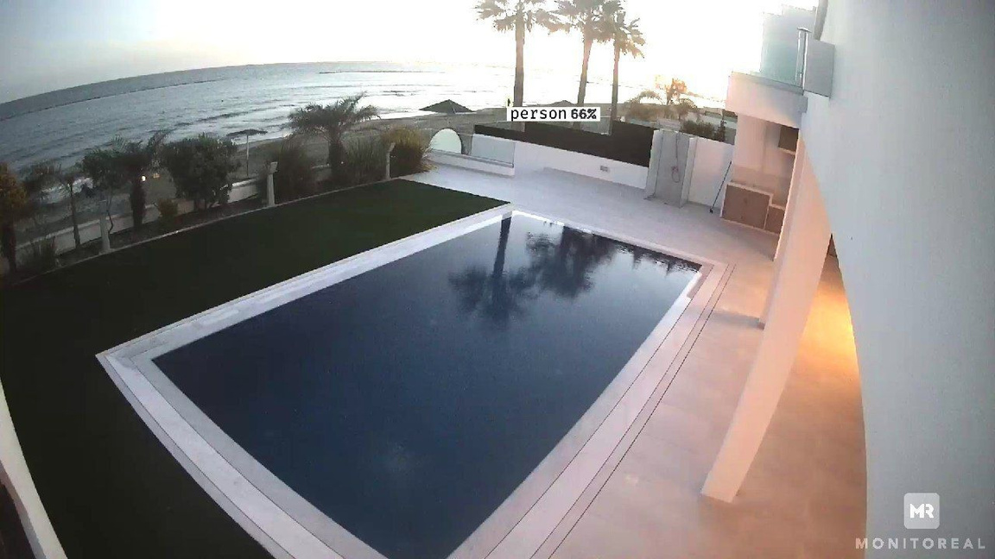
2023 advanced detections
And more
Wild animals detected for community safety (this example is from India)
Person detection from very far away, showcasing advanced capabilities
lax.co.id

Slide 17
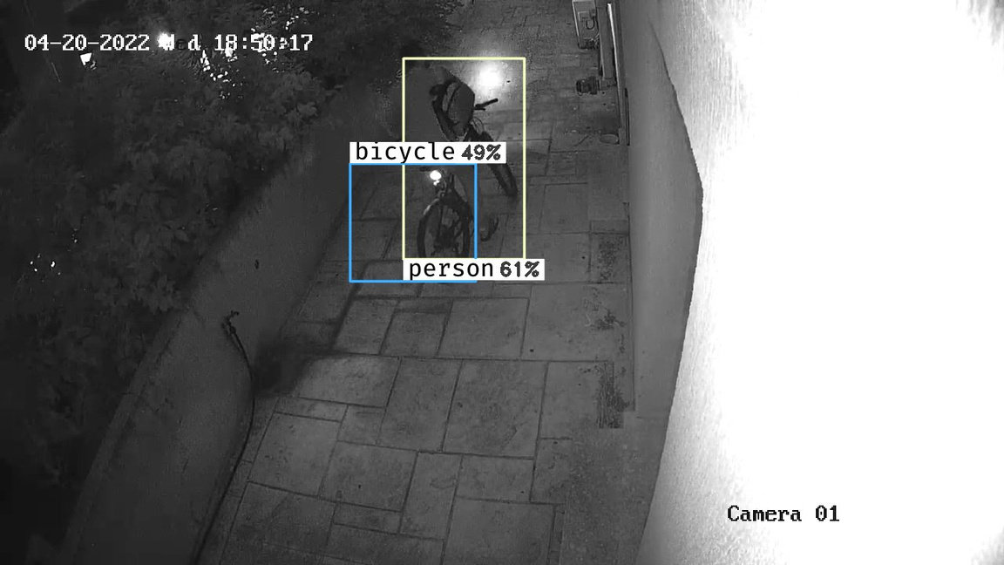
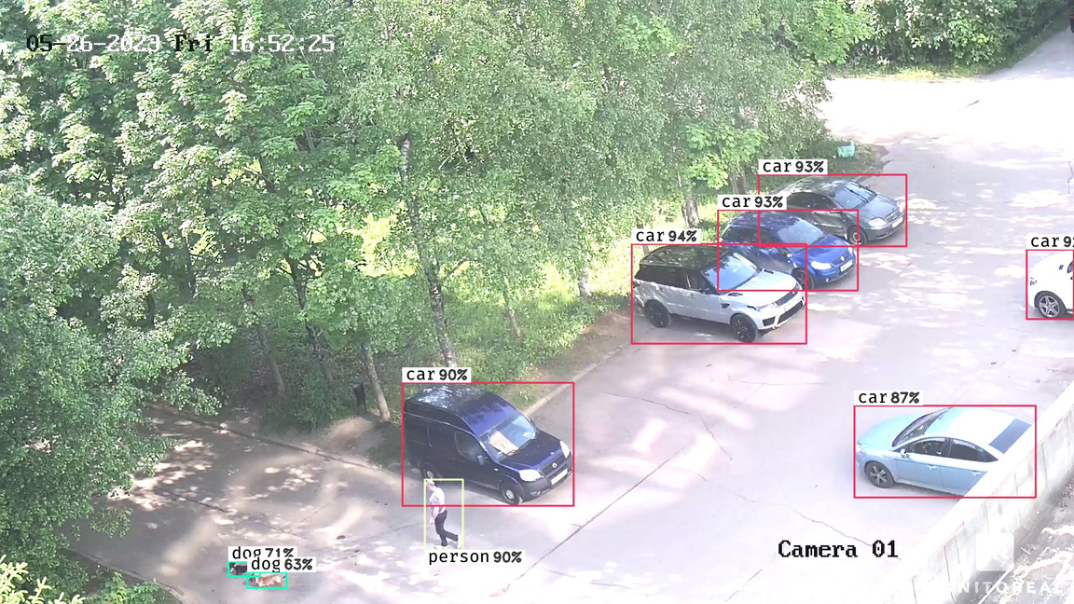
2023 advanced detections
And more
Night-time detection
Detection of vehicles, person, animals in
one snapshot
lax.co.id

Slide 18
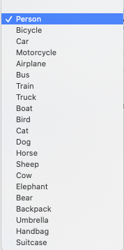
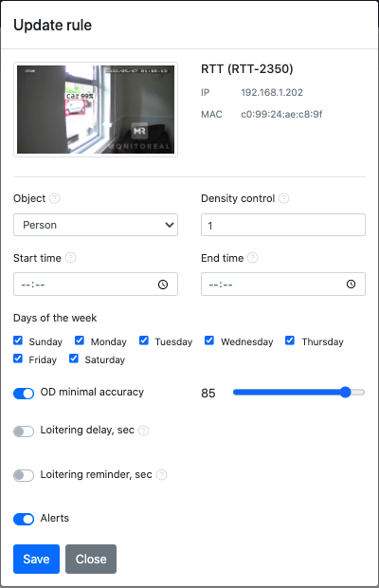
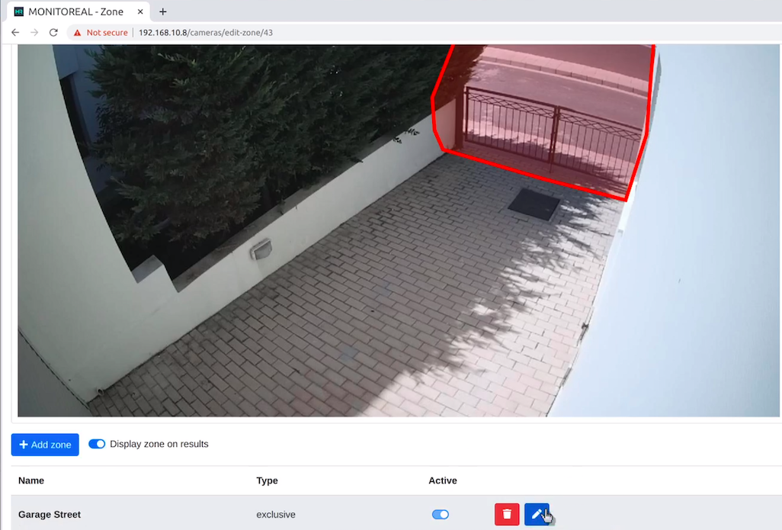
Customisable features
lax.co.id

Slide 19






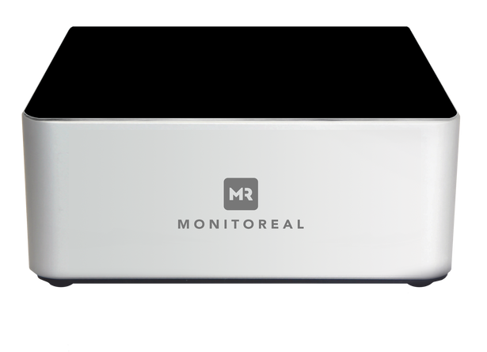









How it works
If you have more than 8 cameras
AI Video Assistant
area
Select up to 8 cameras overlooking critical areas and start receiving alerts by Monitoreal
lax.co.id

Slide 20
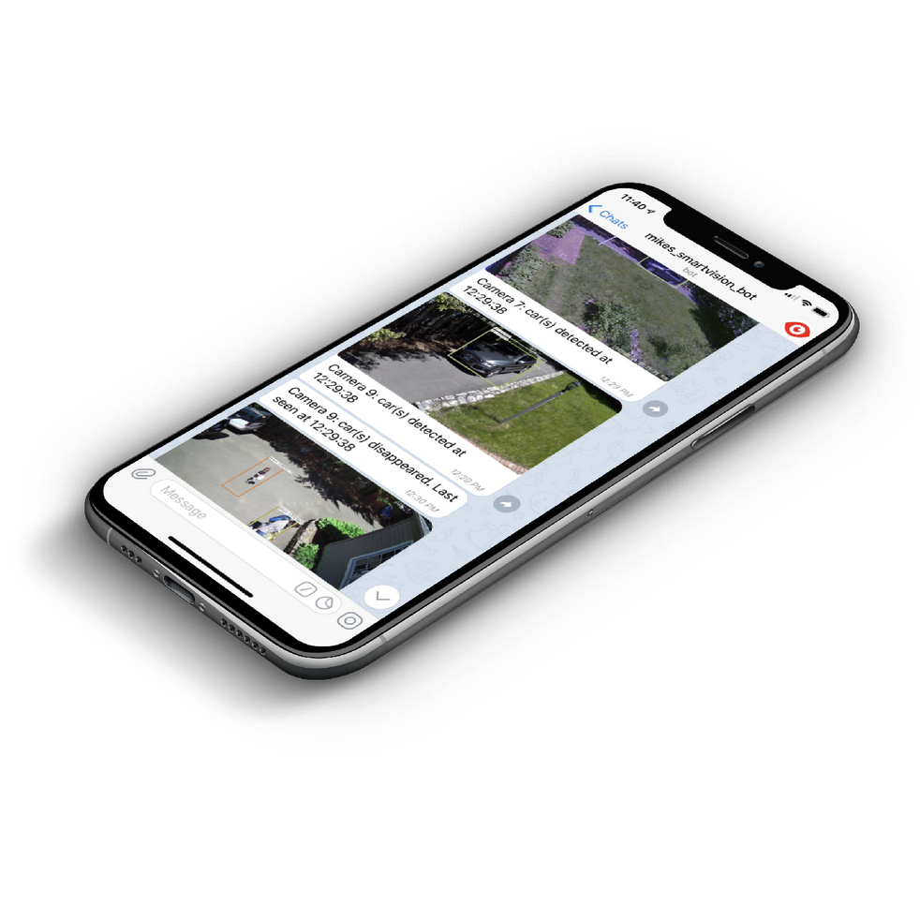

How do you receive alerts?
Flexible notification settings
  Telegram app (recommended)
  Email
  Slack
  Webhooks for integration with Monitoring Stations
  Integration options for Amazon Alexa, Apple HomeKit, Google Assistant, Google Home, Xiaomi Smart Home (Mi Home), MQTT....coming soon!
And you’re all set!
Your Monitoreal device will send you an alert whenever it detects an object matching your preferences
lax.co.id

Slide 21
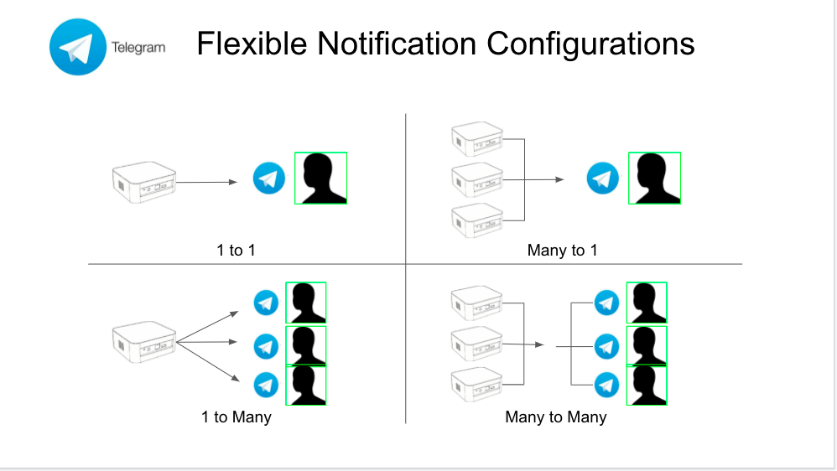
How do you receive alerts?
Telegram notifications configuration
lax.co.id

Slide 22
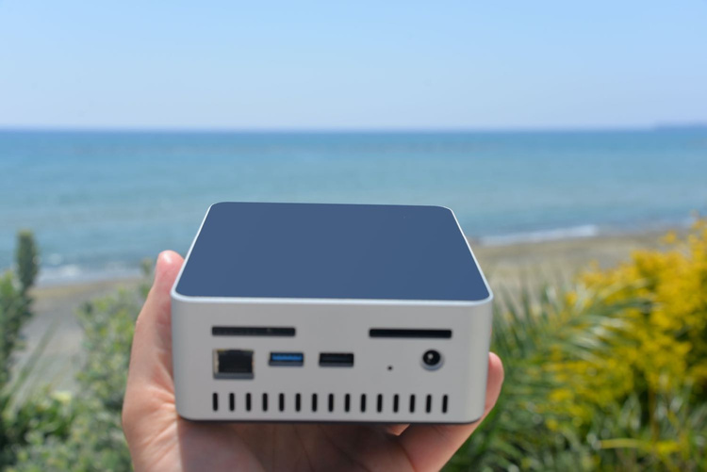



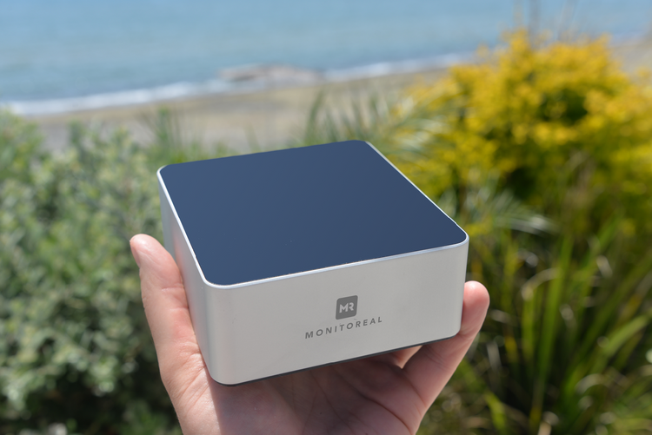

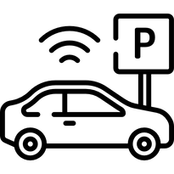
Use cases
Example uses for Monitoreal
Residential
  Detect loitering at your home
  Awareness, not just reactive security
  Trigger an alarm or turn on the lights
  More than one person on your premises?
  Did the gardener turn up?
  Are your children home?
  Is your dog running loose?
  Commercial
  Unauthorised visitors after hours?
  Did the deliveries get dropped off on time?
lax.co.id

Slide 23
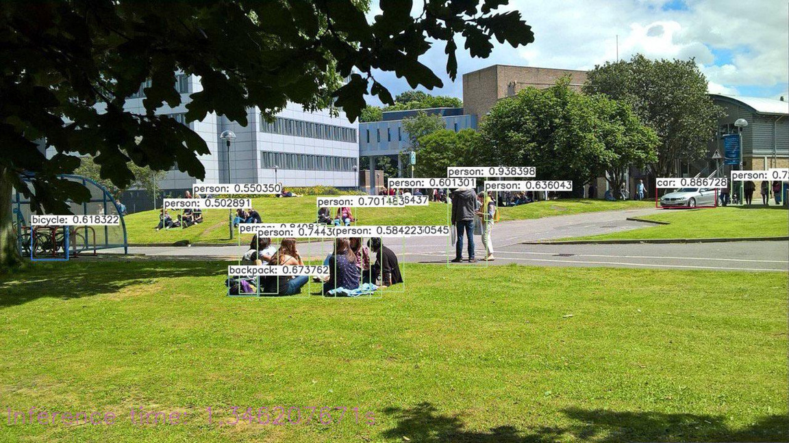
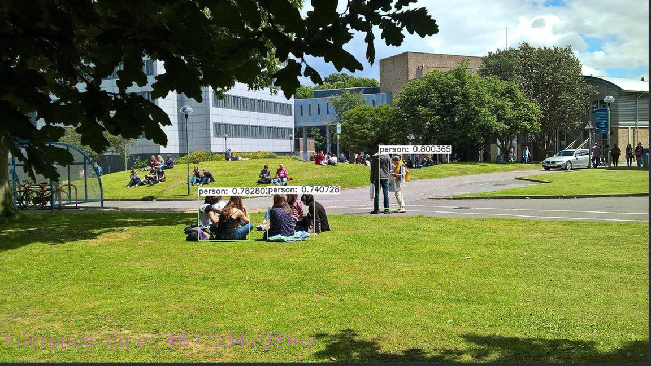
Monitoreal Deep Sight mode
x2 more accurate detection for smaller and distanced objects plus enhanced night vision
Deep Sight mode
available in Pro version
Standard mode
available in Base model
lax.co.id

Slide 24
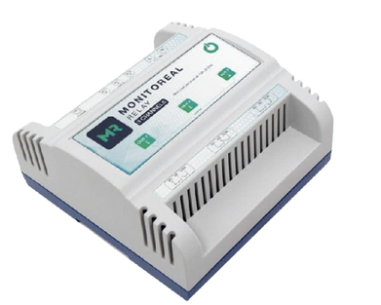



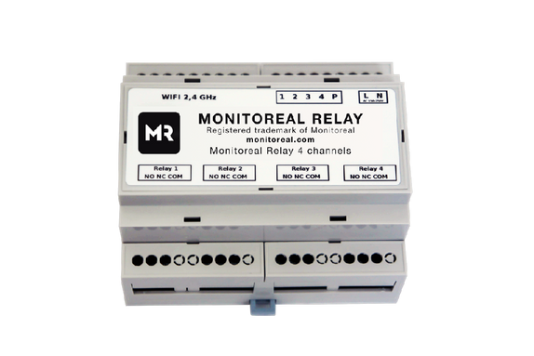

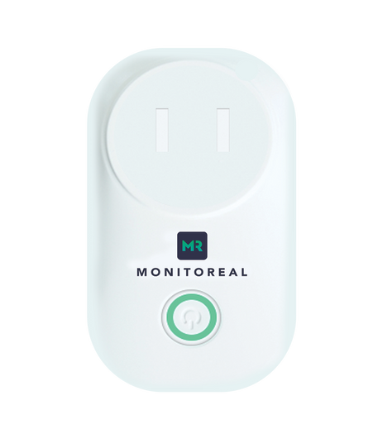

AI-powered accessories
Control connected electrical devices
Network I/O
Opening + closing gates, garages, doors, locks
Control smart lights
WiFi Relay
Control alarms and speakers
WiFi Smart Plug
Any other smart appliances
lax.co.id

Slide 25
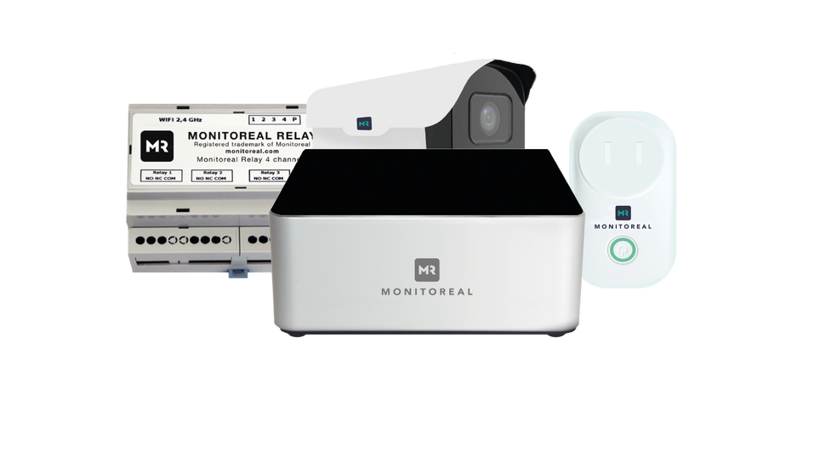



NEW audio warning feature
Create scenarios to deter an intruder from breaking into your property using the audio feature
  sound of dog barking
  pre-recorded speech
  alarm sound
  horn sound
  any other
How it works:
Monitoreal detects potential intruder | Notifies you in real-time | Relay triggers immediately | Audio file plays through Bluetooth speaker
lax.co.id

Slide 26
Monitoreal Relay + Smart Plug
Multiple ways to trigger an action using Monitoreal’s AI Analytics
  Each relay channel can be configured independently
  WiFi Relay (4 output channels)
  Network I/O Relay (3 input channels, 3 output)
  WiFi Smart Plug (1 channel) - plug and play
  Create customised scenarios
  Integrate with your alarm panel to arm and disarm Monitoreal’s analytics
  Pre-configure the length of time an alarm sounds
  Set a light to flash consecutively with the strobe setting
  Link the audio module to a bluetooth speaker e.g. person detected, light activates, audio file of dog barking plays
  Monitoreal can trigger connected devices automatically, semi automatically with validation or manually
lax.co.id

Slide 27
Channel opportunity for professionals
Integrators and installers
AI-analytics appliance: 21 objects, highly accurate!
  Not NVR or VMS - all video storage and review functionality remains the same
  Native NVR analytics are not good enough - too many false alerts or object misclassifications
  Incremental revenue opportunity
  Monetize existing customer installs as an upgrade
  Up-sell new customers and installs with AI computer vision analytics add-on
  Easy to set up and use
  Cameras can be set up quickly - good ‘time to revenue’ ratio
  Intuitive WUI and rule creation - supported by self-help videos on YouTube
  Resources available to support you and your customers
  Affordable and private
  Priced well per channel compared with 3 year total cost of ownership of lower performing Cloud ‘smart’ devices
  All video is processed on premise, protecting the privacy of customers’ business or home
  On trend: AI + video surveillance driving market growth
  AI analytics in the SMB and residential segment is under-served - Monitoreal fills that gap!
lax.co.id

Slide 28
NEW and coming soon
Features and products
Monitoreal App
  Private peer-to-peer connection
  Complete with live view function and WUI settings
  Mobile and desktop versions
  Monitoring station & ARC platform integration
  Video alarm verification using AI object detection vs. traditional solutions e.g. motion detection
  Freedom to customise your regions of interest (ROI)
  Enabling control rooms to ‘really see what’s going on’
SSD Storage Expansion and NVR functionality
Monitoreal Security Cameras
  Compatible, stable and ready to use
lax.co.id

Slide 29








Contact us
www.lax.co.id
Ruko Aralia, Blok HY43 No.40, Pusaka Rakyat, Kec. Tarumajaya, Bekasi, Jawa Barat 17214
info@lax.co.id
Marketing Office
Jl. Angkasa No. 32 Blok A10
Jakarta Pusat – Indonesia
lax.co.id

Slide 30
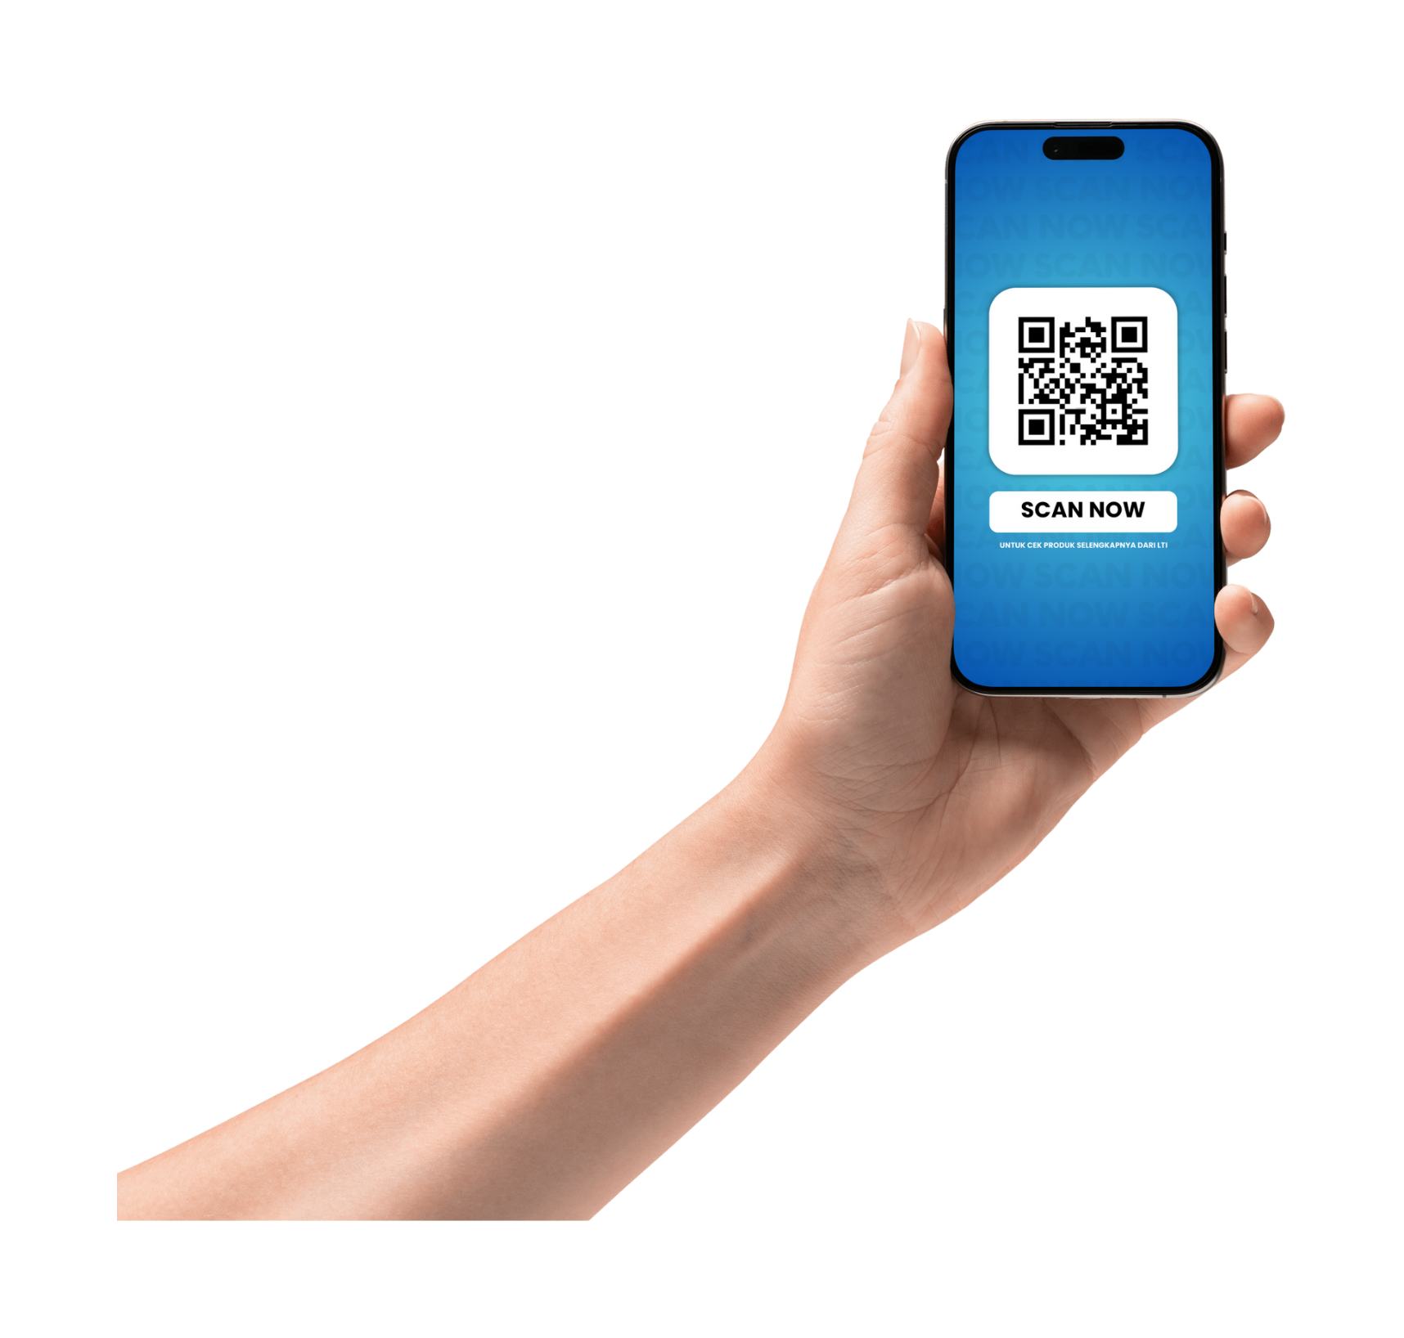




WWW.LAX.CO.ID
PT. LAX TEKNOLOGI INDONESIA
: Ruko Aralia, Blok HY43 No.40,
Pusaka Rakyat, Kec. Tarumajaya,
Bekasi, Jawa Barat 17214
Marketing Office
Jl. Angkasa No. 32 Blok A10
Jakarta Pusat – Indonesia
: https://lax.co.id/
: info@lax.co.id

